Slide 1
Alt Text to Graphs

Slide 2
Think of alt text descriptions for the following graphs/images.

Slide 3
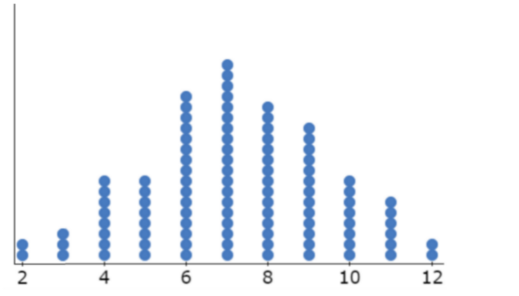
What is the context? What is being asked? Who is my audience?
Notes:
What is the context? What is being asked? Who is my audience?
We need to know something else, right?
What is the context? What is being asked? Who is my audience?

Slide 4
Audience: Intro Statistics course
Context: Shapes of distributions; this shows the sum of 2 dice when rolled 100 times.
Question: Describe the shape

Slide 5
Possible: Dot Plot that spans from 2 to 12, with a couple of observations at 2 and 3 at 3, steadily increasing to a peak at 7 and then slowly decreasing, ending with 2 observations at 12.

Slide 6
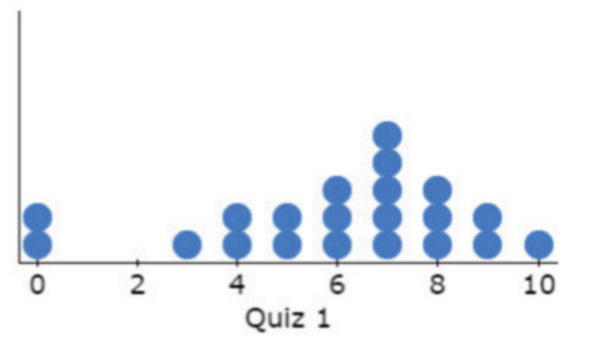
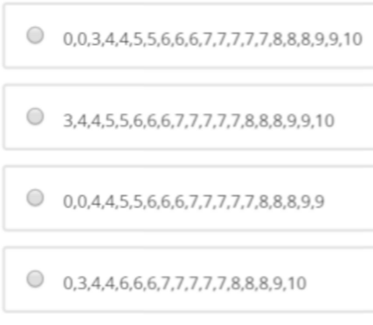
Context: Distribution of quiz scores; interpreting dot plots
Question: Which dataset goes with the dot plot.

Slide 7
Possible: A dot plot with two dots at 0, 1 dot at 3, 2 dots at 4, 2 dots at 5, 3 dots at 6, 5 dots at 7, 3 dots at 8, 2 dots at 9, 1 dot at 10

Slide 8
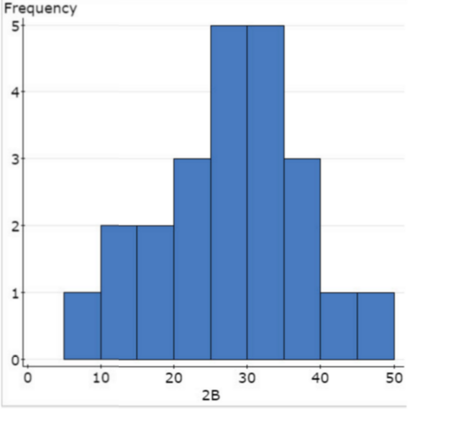
The histogram above represents the number of "doubles" hit by Hank Aaron over his career. ( A double is when a batter makes it to second base in one time at bat.)
Determine the number of years for which the data is recorded.

Slide 9
Possible: a histogram with a horizontal axis representing the number of doubles and a vertical axis representing the frequency. The values on the horizontal axis range from 5 to 50 with a bin width of 5. The first bin from 5 to 10 has a height of 1; the 2nd bin from 10 to 15 has a height of 2; the 3rd bin from 15 to 20 has a height of 2; the 4th bin from 20-25 has a height of 3, the 5th and 6th bin from 25 to 30 and 30 to 35 both have a height of 5; the 7th bin from 35 to 40 has a height of 3; the 8th and 9th bin from 40 to 45 and 45 to 50 both have a height of 1.

Slide 10
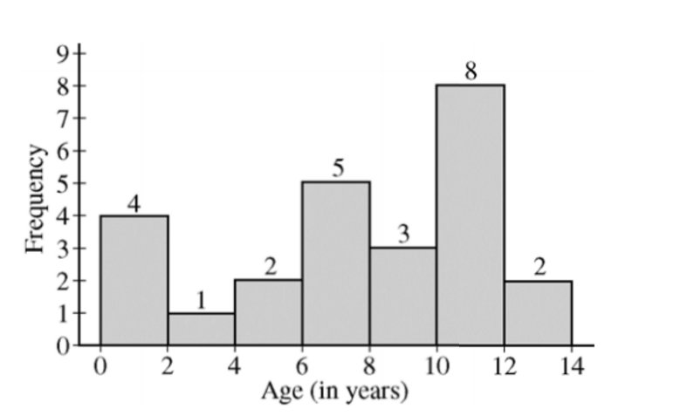
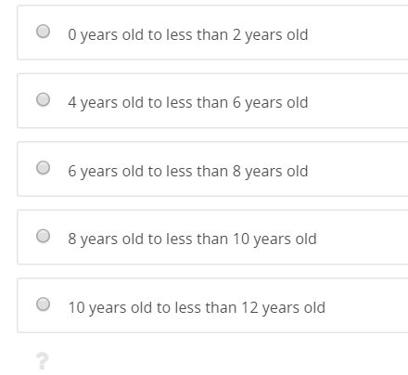
A random sample of 25 households from a school district was surveyed. In this survey, data were collected on the age of the youngest child living in each household. The histogram below displays the data collected in the survey.
In which of the following intervals is the median of these data located?

Slide 11
Possible: A histogram of a random sample of 25 households with the horizontal axis representing the age (in years) and the vertical axis is the frequency. The first bin is [0,2) at 4; the 2nd bin is [2,4) at 1; then [4,6) at 2, then [6,8) at 5, then [8,10) at 3, then [10, 12) at 8, and finally from [12,14) at 2.
In which of the following intervals is the median of these data located?
Notes:
There are 25 data values. The median is the middle data point, which in this problem is the 13th value. This falls in the 8 year old to less than 10 year old range.

Slide 12
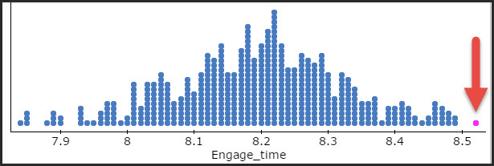
The mean number of minutes for app engagement by a tablet user is 8.2 minutes. Suppose the standard deviation is one minute and it is modeled well by a normal curve N(8.2, 1). A new version of the app was created and the developer wanted to know if the new app had similar engagement time and sampled of 60 users. What value of the sample mean would be consistent with the population being N(8.2,1)? To investigate this, you simulated 500 samples for n = 60 from a population that is N(8.2,1), which is shown below in the dot plot of sample means minutes of engagement time with the app.
What does the one dot at about 8.52 represent?

Slide 13
Possible: Dot plot that is mound shaped with values ranging from about 7.8 to 8.52. There is one dot that is highlighted at the extreme right at about 8.52.
Notes:
Since this is a dotplot of sample means, then each dot represents one of the 500 simulations. This particular dot represents a sample mean of 8.52 minutes of app engagement for one of the 500 simulations.

