Slide 1
Confidence Intervals Introduction

Slide 2
Example 1
Suppose that a market research firm is hired to estimate the percent of adults living in a large city who have cell phones. Five hundred randomly selected adult residents in this city are surveyed to determine whether they have cell phones. Of the 500 people surveyed, 421 responded yes - they own cell phones. Using a 95% confidence level, compute a confidence interval estimate for the true proportion of adult residents of this city who have cell phones. (from OpenStax: Introductory Statistics)

Slide 3
Step 1. Verify the conditions. Make sure there are no “red flags”
  SRS?
  10%?
  ✓
  ✓
  ✓
Notes:
Step 1 is to verify the conditions 1) Does it come from a simple random sample? (Yes. It says that 500 adults were randomly selected…have to assume simple random sample) 2) is 500 less than 10% of the total population? (Yes, it says sampled from a large city.) 3) Large count condition. This requires us to find p-hat, which is x/n or 421/500 which = 0.842. Plugging this into the formula gives us: 500(.842) which is greater than 10 (its 421) and 500(1-.842) >10 and it is (at 79). Now that our conditions are satisfied, we can use our confidence interval formula with z* = 1.96 (which corresponds to the 95% confidence interval.

Slide 4
We are 95% confident that the true proportion of adults in this city who own cell phones is between 81.0% and 87.4%.
We are 95% confident that between 81.0% and 87.4%. of adults residents of this city have cell phones.
Notes:
Substituting the values, gives us…
Crunching out the standard error gives us 0.016312 (be sure not to round too early)
Multiplying the critical value by the standard error (to get the margin of error) gives us 0.842 +- .0320.
Now we should interpret the interval: Here are two ways we could write it.

Slide 5
Suppose that someone claimed that over 90% of adults in that city have a smartphone. Based on your confidence interval obtained, comment on this claim.
  Note that our 95% confidence interval (81.0%, 87.4%), which gives an interval of plausible values, does not contain 90%. This would cast doubt on this person’s claim.

Slide 6
Using Technology
Suppose that a market research firm is hired to estimate the percent of adults living in a large city who have cell phones. Five hundred randomly selected adult residents in this city are surveyed to determine whether they have cell phones. Of the 500 people surveyed, 421 responded yes - they own cell phones. Using a 95% confidence level, compute a confidence interval estimate for the true proportion of adult residents of this city who have cell phones. (from OpenStax: Introductory Statistics)
Notes:
It is good that you can develop these by hand without the use of technology, except for the basic arithmetic aspect. Fortunately, the TI-84 and StatCrunch can both be used to construct the confidence intervals. We will look at an earlier example we did by hand. When using technology, we still need make sure the conditions are satisfied. We’ve done this already in the by-hand version. We will use both the TI-84 and StatCrunch. We’’ll start with the TI-84 {{{Advance slide}}}

Slide 7
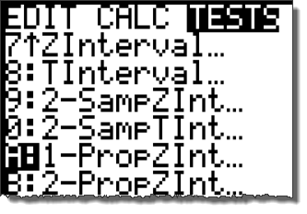
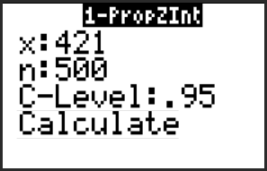
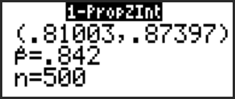
Step 1. Press STAT and scroll to TESTS. Select A: 1-PropZInt.
Step 2. Input the x, n, and select the confidence interval and select “Calculate.”
You will see the interval displayed along with p̂ and n.
Notes:
Go through the steps.
…Note that the calculator gives the interval (.810, .874). Which is the same we obtained by hand. However, if we needed it the +- notation, we will need to determine the margin of error by subtracting the (upper bound – lower bound)/2 which will give the margin of error. Thus, using our formula of p-hat +- margin of error, we get .842+-.320, which is the same we obtained by hand.

Slide 8
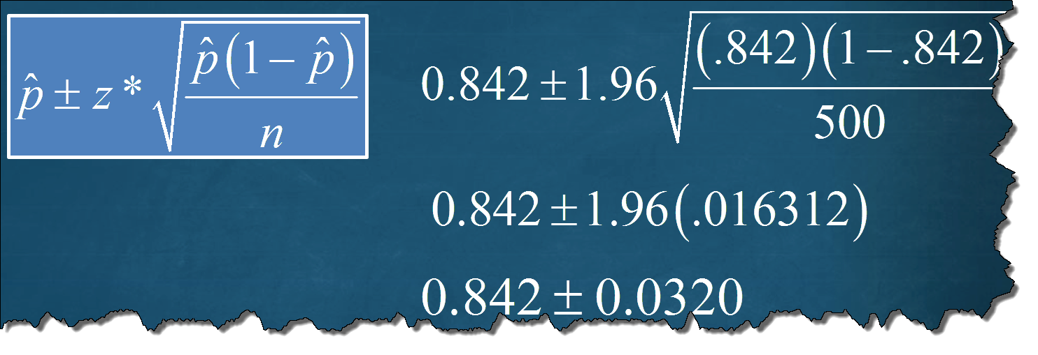
Step 1. Press STAT and scroll to TESTS. Select A: 1-PropZInt.
Step 2. Input the x, n, and select the confidence interval and select “Calculate.”
You will see the interval displayed along with p̂ and n.
Notes:
Go through the steps.
…Note that the calculator gives the interval (.810, .874). Which is the same we obtained by hand. However, if we needed it the +- notation, we will need to determine the margin of error by subtracting the (upper bound – lower bound)/2 which will give the margin of error. Thus, using our formula of p-hat +- margin of error, we get .842+-.320, which is the same we obtained by hand. Here is a screenshot of our “by-hand” example, remember…. While it is very nice that calculators and computers can construct these intervals with ease, doing these by hand in the beginning will give you a better feel for how each parameter effects the interval. For instance, by-hand, not only is it more clear that increasing the sample size will decrease the margin of error, we e en get a since by what amount. That is, if we want to cut the margin of error in half, we need to quadruple the sample size. This is very difficult to see if we use the calculator at the beginning.

Slide 9
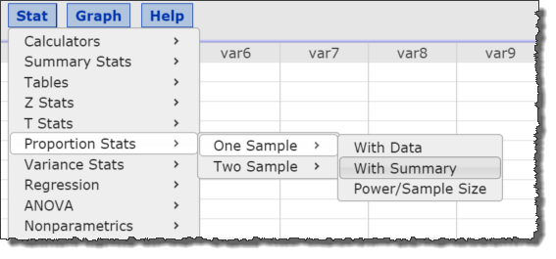
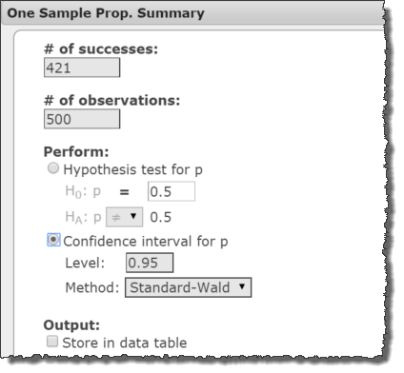
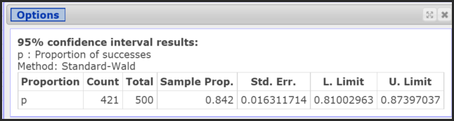
Step 1. In StatCrunch go to Stat→Proportion Stats→One Sample→With Summary
Step 2. Enter in the values for the # of success (421) and # of observations (500). Select “Confidence interval for p” and enter the level. For “Method,” select “Standard-Wald” and press “Compute.”
Notes:
To do this same problem in StatCrunch, go to Stat→Proportion Stats→One Sample→With Summary. Step 2. Enter in the values for the # of success (421) and # of observations (500). Select “Confidence interval for p” and enter the level. For “Method,” select “Standard-Wald” and press “Compute.” Always glance at the count and total to make sure you put these in correctly. Note the sample prop, which is p-hat and Std. Err, which we have seen before by hand and the TI-84. The interval would be (.810, .874), which, of course, is the same as before.

